Slide 1
Analyzing Polarization in Online Discourse on the 2023–2024 Israel–Hamas War
Daniel Miehling, Daniel Dakota & Sandra Kübler (Indiana University)
Keywords: YouTube / ABSA / Web 2.0 / CL
25.08.2025

Slide 2
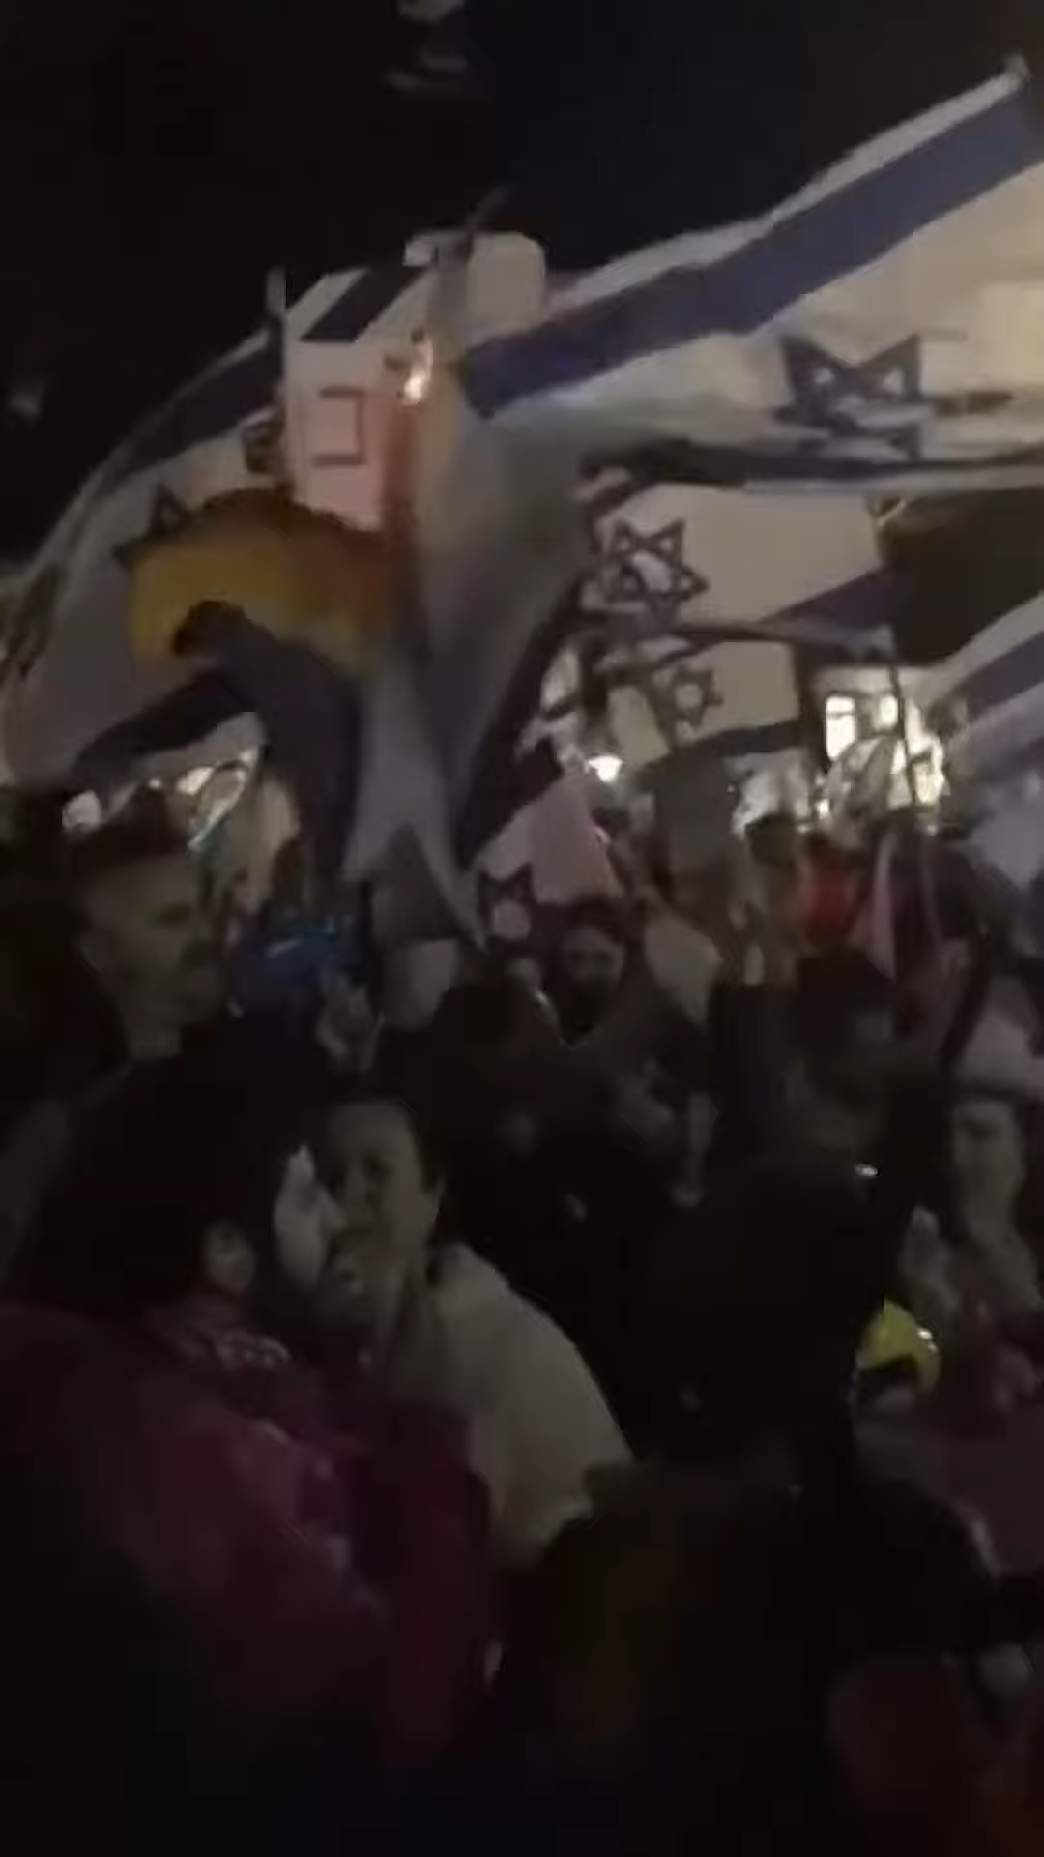
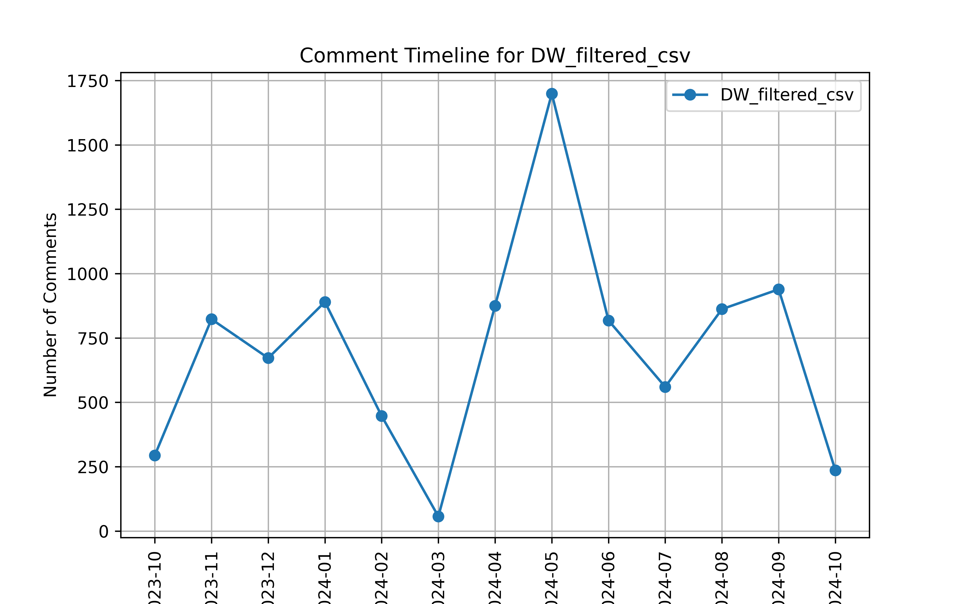


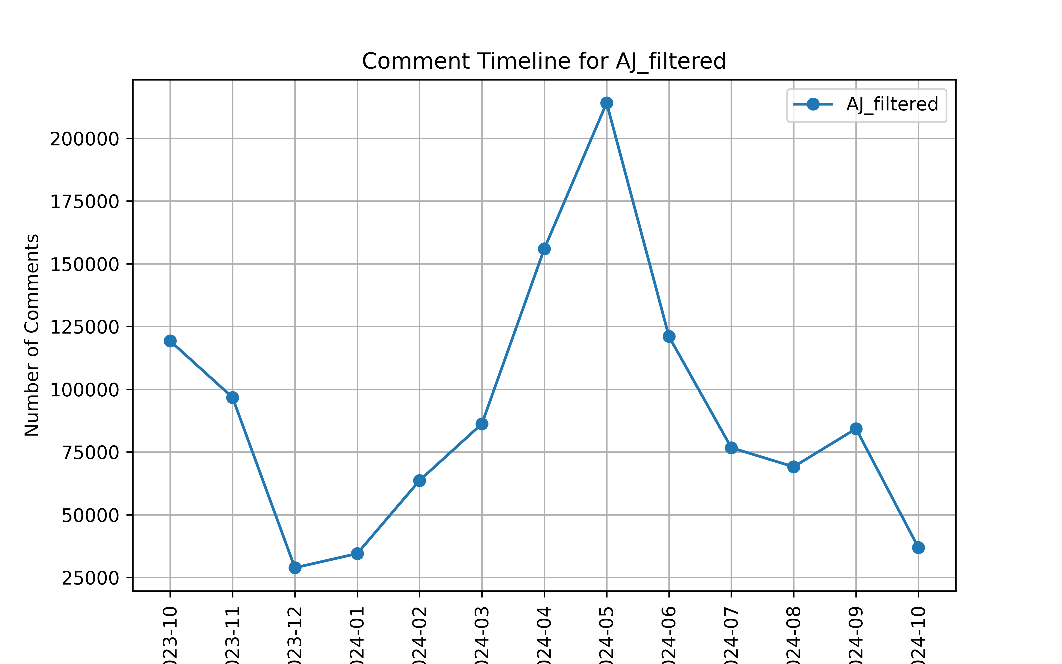
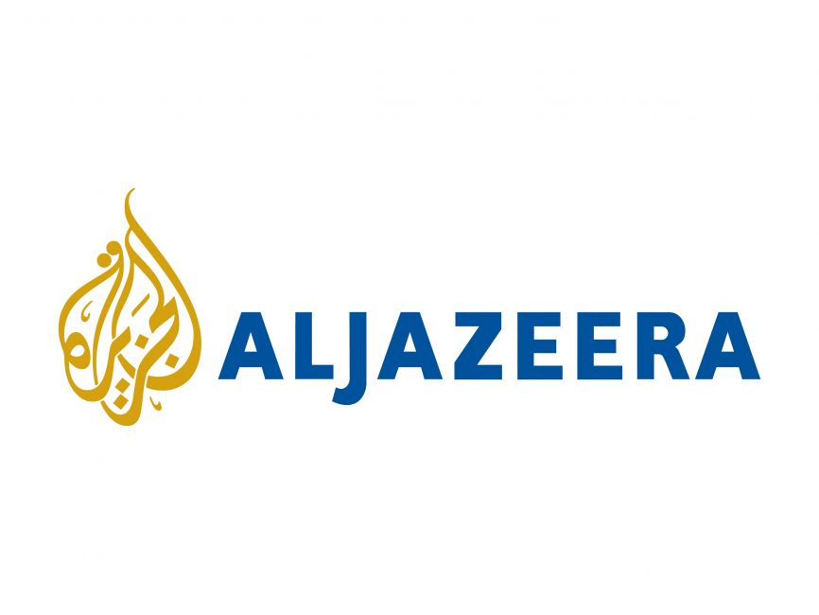
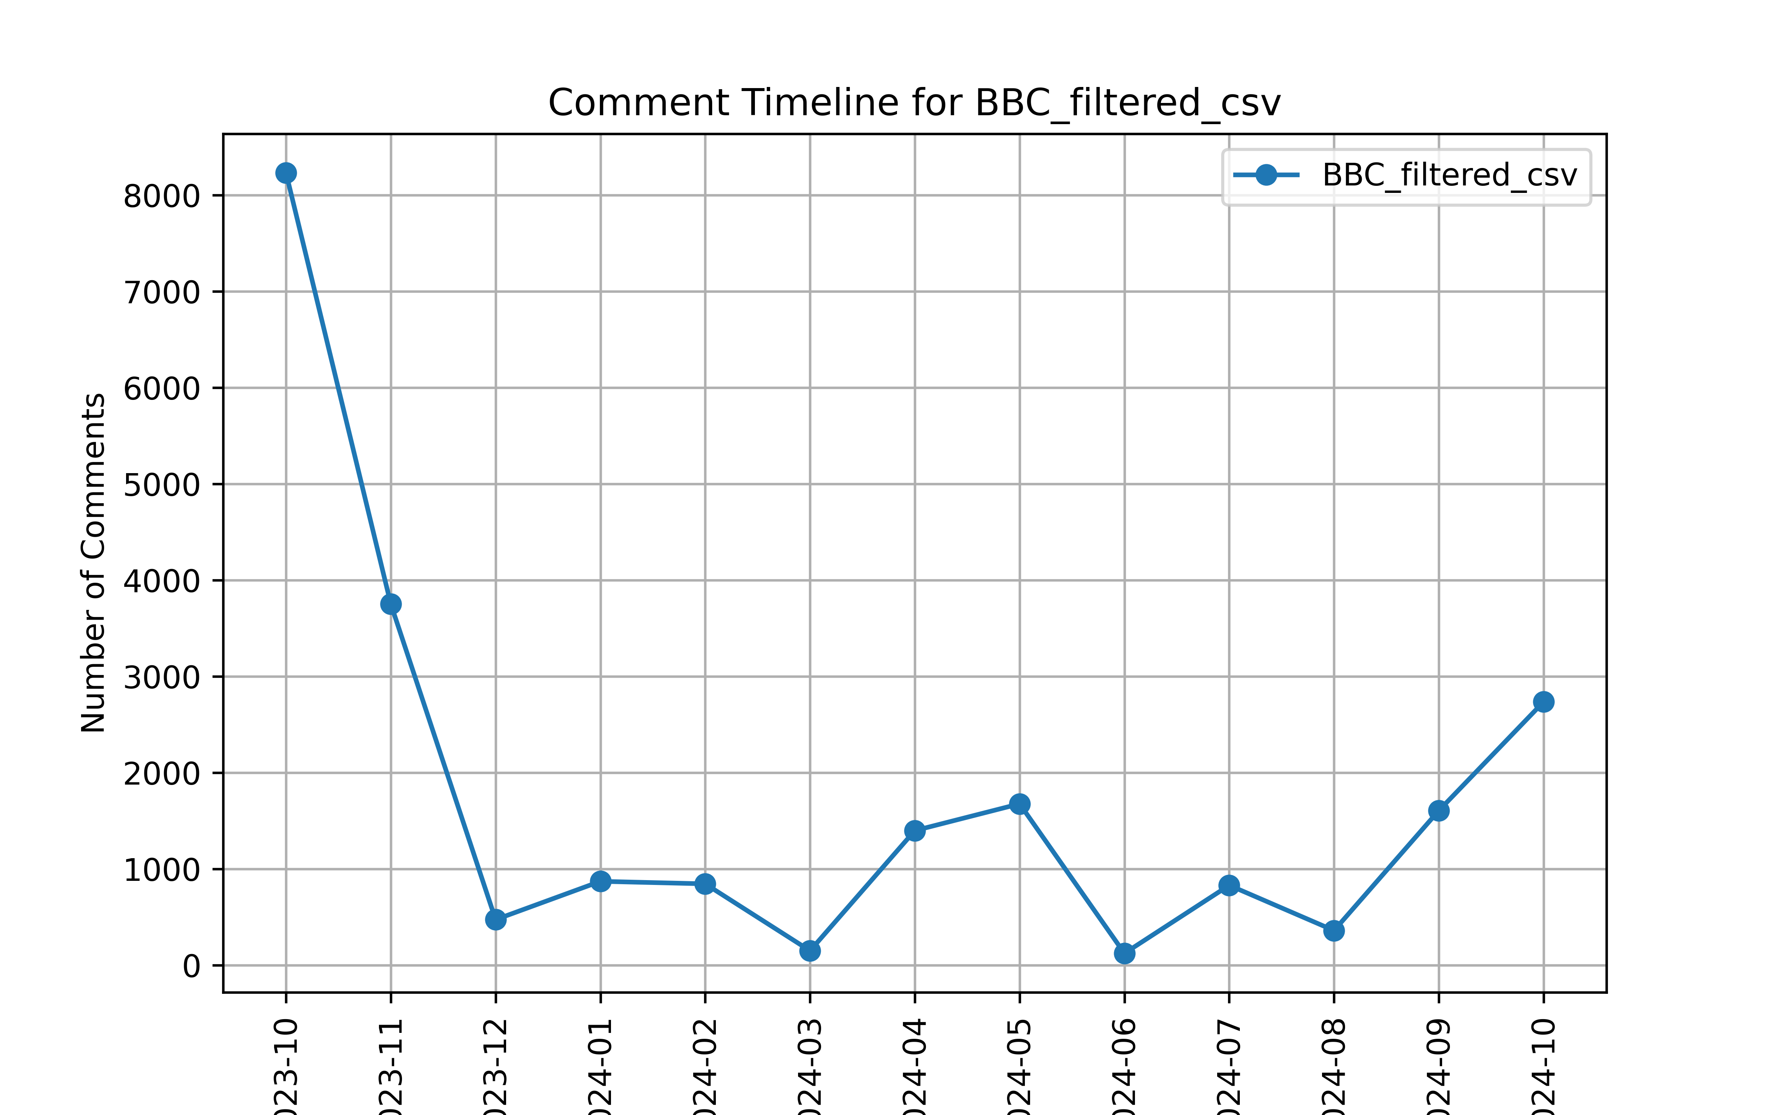

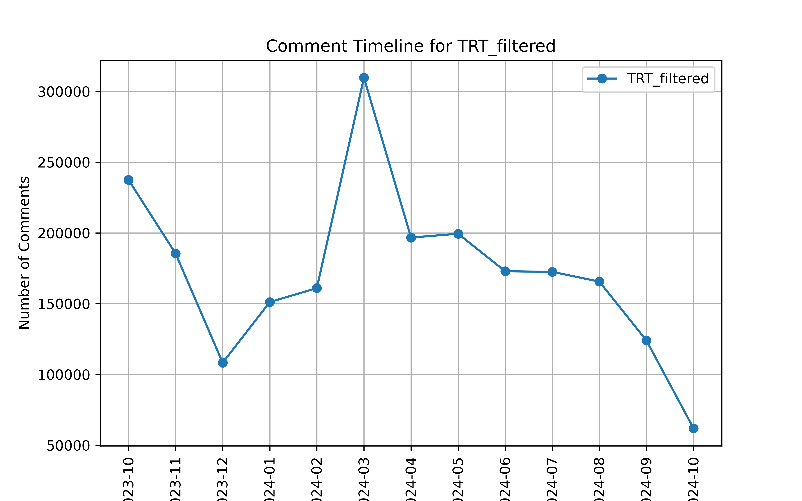

Motivation: Why YouTube Shorts matter
In 2024, over 71.4B monthly visits on avg. by 3.5B unique users¹
Our dataset
🎥 2,370 YT Shorts
💬 3.44M comments and replies 👥 787k users
2
Source:
1 The data provided for this purpose originates from the ‘DataReportal’ portal and can be accessed at the following URL: https://datareportal.com/reports/?tag=Global, last checked 06.06.2024

Slide 3
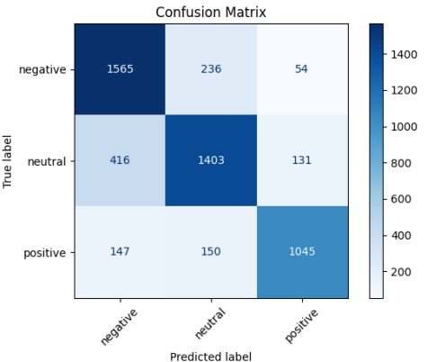
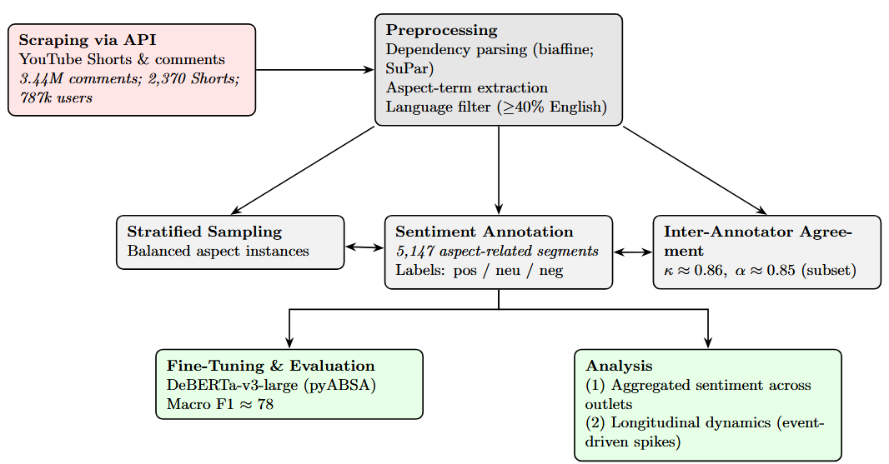
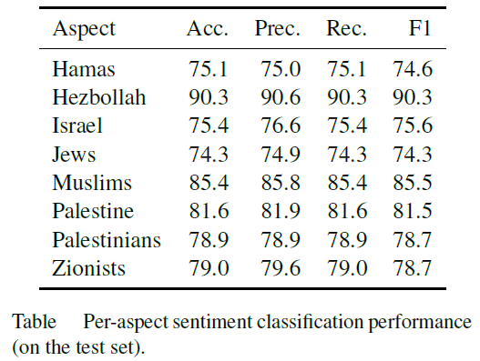
Method
Pipeline: Preprocessing → Annotation → Aspect-based Sentiment Analysis → Aggregated Sentiment & Longitudinal Dynamics
3

Slide 4
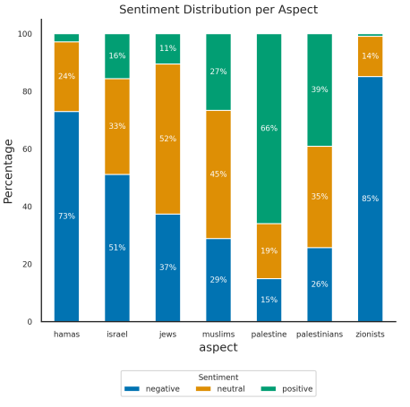
Aggregated Sentiment Distribution
Sentiment Distribution per Aspect
Aggregated yearly sentiment shows a dominant trend of negativity toward:
Israel; Zionists; (To a lesser extent) Jews
In contrast, Palestinians and Muslims receive more neutral or mixed sentiment.
Notably:
85% of sentiment toward “Zionists” is negative
This is higher than for “Hamas” (73%)
Indicates that Zionism is framed more ideologically and contentiously than militant actors.
Suggests a shift in mainstream digital discourse where anti-Zionist sentiment exceeds criticism of terrorism-related entities.
4

Slide 5
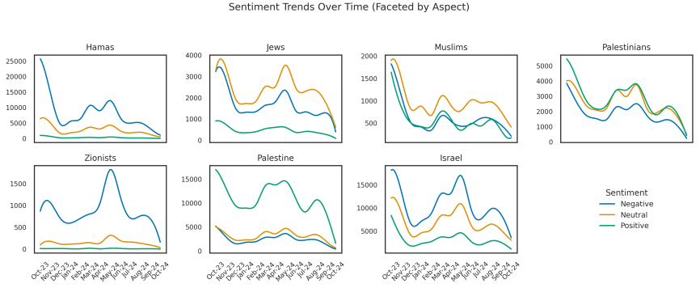
Longitudinal Dynamics
5

Slide 6
Qualitative Patterns
Identified Linguistic Concepts linked to
Semiotic Markers as Visual Amplifiers
ABSA allows fine-grained Sentiment Analysis
(1)
Victory ✌️ to HAMAS-HEZBOLLAH-ANSARALLAH---IRAN Free Palestine 🇵🇸🇵🇸🇵🇸💚☪️ Allahuakhbar Malaysia 🇲🇾🇲🇾🇲🇾🔻🔻
(5)
Free Palestine from Hamas
🔻 🔻 🔻 🇮🇱🤡 🇮🇱🤡 🇮🇱🤡
🇵🇸✌️🇮🇩 🔻 🇮🇱
(2)
Conceptual Ambiguity increases risks of false-positives
ABSA reveals Potential Support Terrorism and Denial
(6)
Free pagers for Palestine
(3)
This is not true. Western media are spreading rumours against Palestine. Can you give me a proof that Hamas warriors killing babies????
Selective Approval
There are plenty of Jewish people fighting for Palestinian independence, we should not conflate Jewish people with the genocidal state of Israel.
(7)
(4)
I don't remember October 7 but i do remember 75 years of murder of palestinians
6

Slide 7
Conclusion and Reflections
Large-scale ABSA of User-generated Content on YT Shorts captures meaningful polarization.
Persistent normalization of anti-Zionist sentiment in Mainstream Web.
Spikes correspond to cultural and geopolitical flashpoints but also echo entrenched resentment.
Future work: Extend into multimodal analysis + more aspect categories — combining text, speech, and video features to better capture coded language and non-verbal cues.
Thanks for your attention!
Dr. Daniel Miehling
Indiana University Bloomington
damieh@iu.edu
https://damieh1.github.io/
25.08.2025

Slide 8
How ABSA works
Annotation to Fine-Tune a Pre-Trained Model for Aspect-Based Sentiment Analysis (ABSA)
Aspect-based Sentiment Analysis (ABSA)
Analysis of Sentiment polarity in User-Generated Content
ABSA Annotation:
Manual labelling of comments
deberta-v3-large-absa-v1.1 fine-tuning
Sentiment polarity: positive, neutral, negative
“Hamas being labeled as terrorist group is just a label. They are resistances against occupation and atrocities... Some countries like Israel and America have caused more dead a terror... but you can’t label them Terrorists because they are countries”
Fine-grained Analysis of multiple aspect categories
Jews
Zionists
Israel
“So what. The Israeli government IS committing genocide. Just look at the civilian death tolls. That doesn't diminish the need to condemn Hamas for their terrorist and bloody attack on civilians. Both can be true at the same time. Greta is awesome. She didn't back down, but she remained calm. As a fellow Swede, I'm very proud of her.”
Palestine, Palestinians
Muslims
Hezbollah, Hamas
8
Sources:
Yang (2021): https://huggingface.co/yangheng/deberta-v3-large-absa-v1.1

